Slide 2

RELATIONAL DATABASES
Prof. Salim Arfaoui
Spring 2023

Slide 3
Today’s Plan
Review:
Software Architecture
Data vs Information
Relational Database Structure
Database Management Systems
New: Database Development Life Cycle (DB SDLC)
Requirement Specification
Conceptual Data Modeling
Logical to Physical Data Model
In-class Practice
Database Implementation (Create and Manipulate)
Next Time

Slide 4



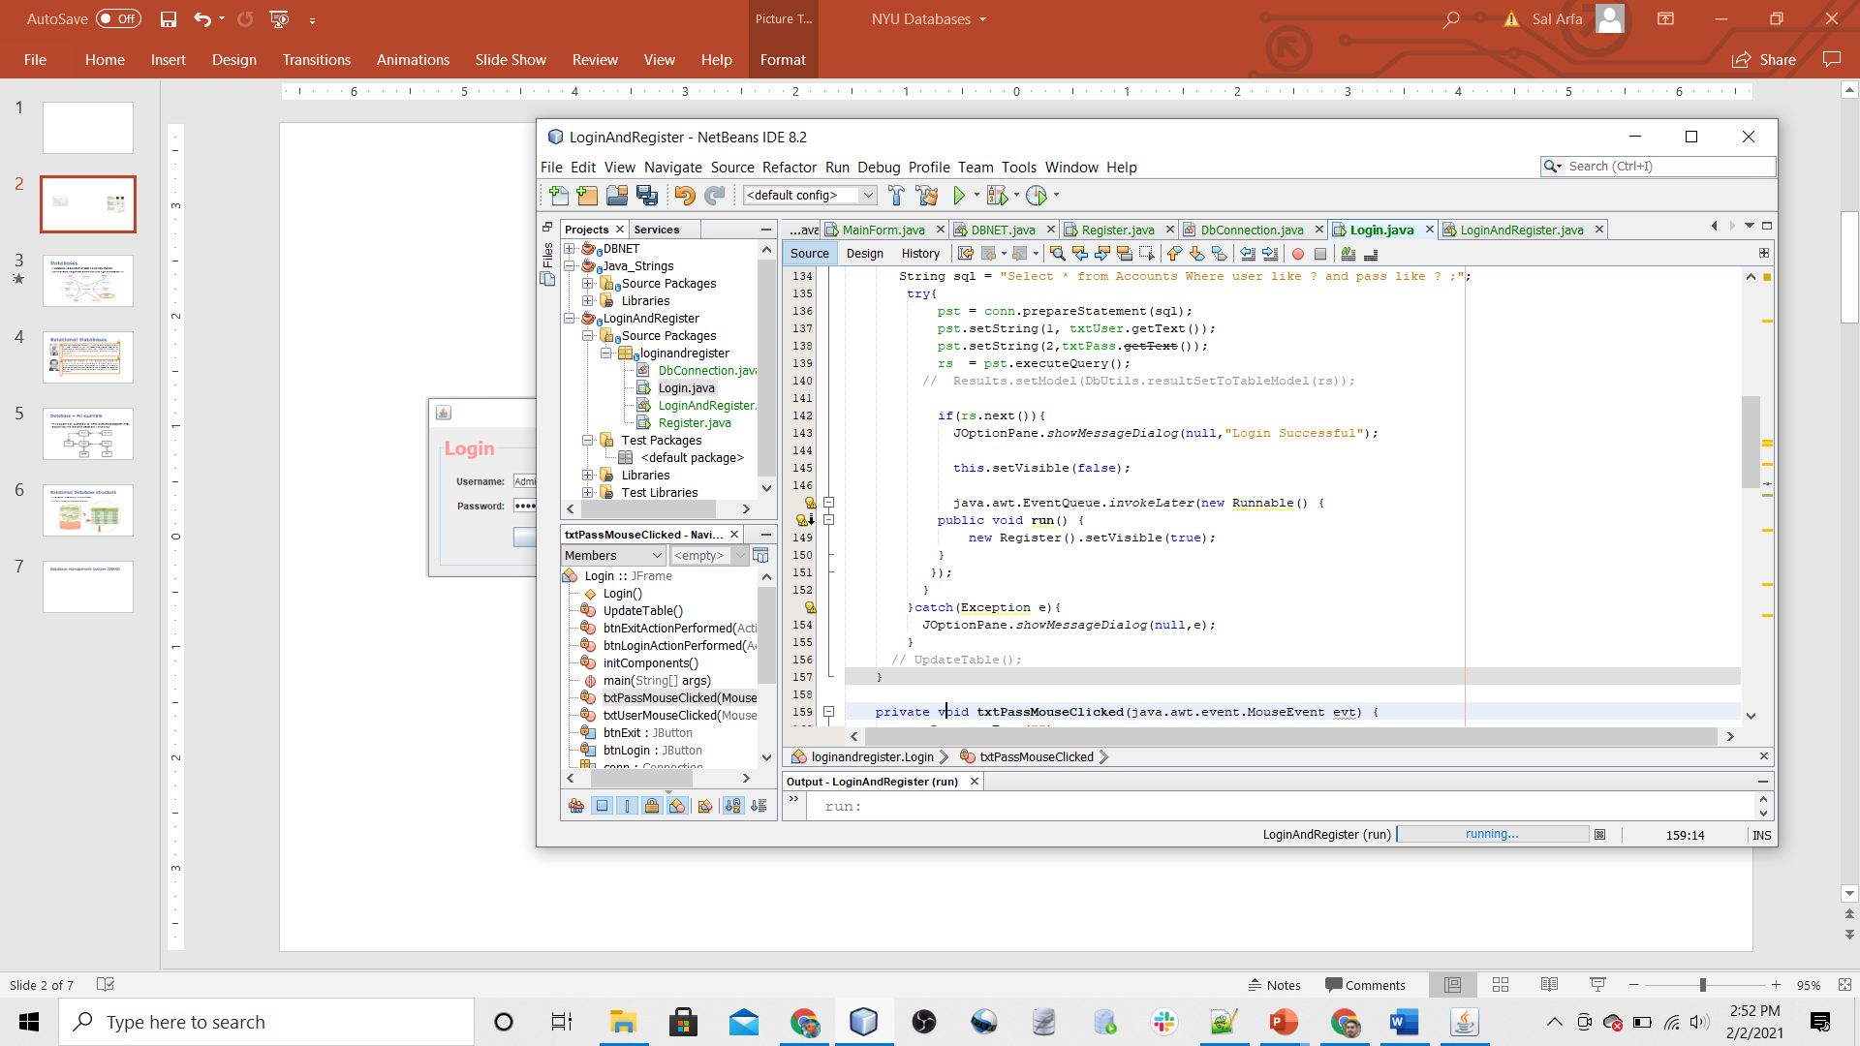
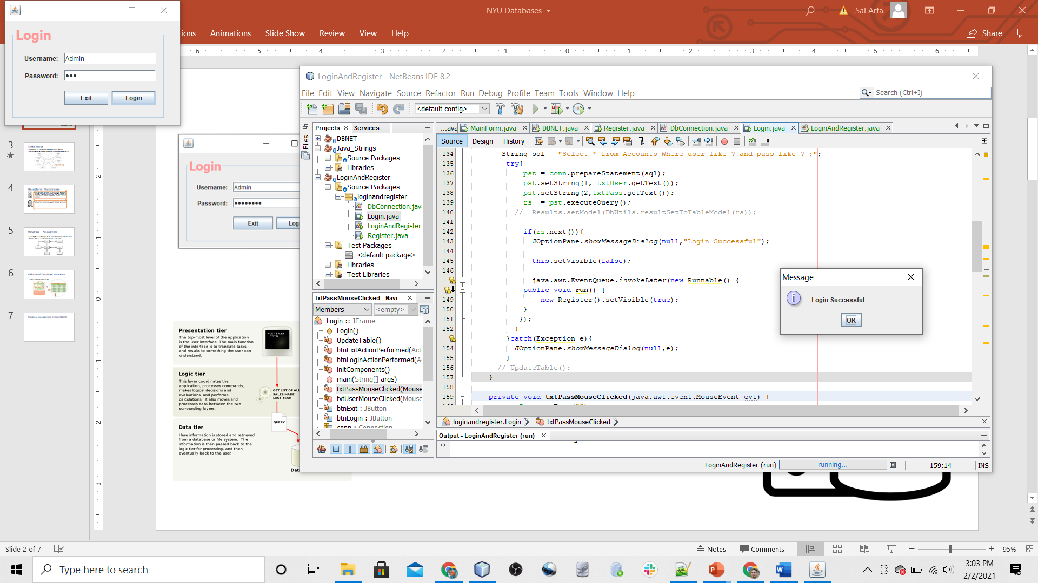
Software Architecture
Presentation tier
Logic tier
Data tier
Query:
Does Admin 123456 Exist?
Authenticate
Return: True
Display result

Slide 5

Data vs Information
Data (datum) :
Raw single units that contain unprocessed facts or raw numbers.
Has not yet been Interpreted.
Not put into context.
Measured in raw units like bits and bytes
Information:
Interpreted collection of data.
Provides context for data.
Measured in meaningful units like time, quantity, etc

Slide 6
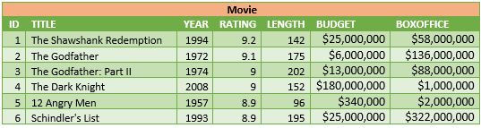
Data vs Information
Data (datum) is raw single units that contain unprocessed facts or raw numbers. It has not yet been interpreted or put into context.
Information is an interpreted collection of data.
Data: Movies ID, Movie title, Year, Rating, Length, Budget, etc.
Information: The movie with the highest budget. → The Dark Knight
Average budget for all movies. → $41,556,666.67
The count of movies with ratings above 9 → 4 movies

Slide 7
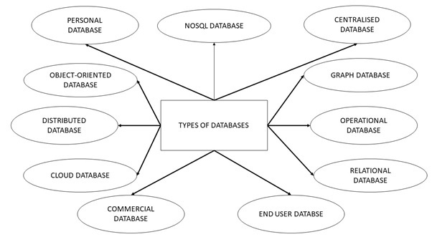
Databases
A database is a collection of data in a defined structure.
How that data is organized determines what type of database it is.

Slide 8
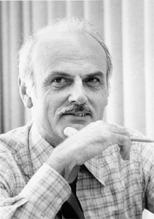
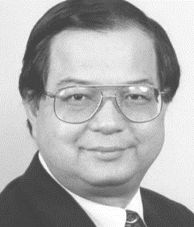
Relational Databases
Edgar Frank Codd, Born August 19, 1923, Portland, UK; A researcher at I. B.M.; recipient of the 1981 ACM Turing Award, applying his knowledge of mathematical logic, was able to introduce an abstract model for database management: principles of relational databases.
Peter Chen Born January 3, 1947, Taichung City, Taiwan; The originator of the Entity-Relationship Model (ER Model) which serves as the foundation and the Meta model for information systems. He invented the concepts and symbols for the ER Model. His modeling ides has been widely used to depict the data in a relational database.

Slide 9
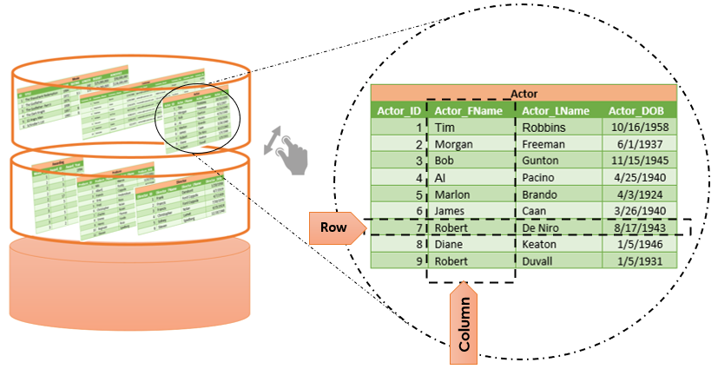
Relational Database Structure
A database is composed of interrelated tables.
A table is composed of columns and rows

Slide 10

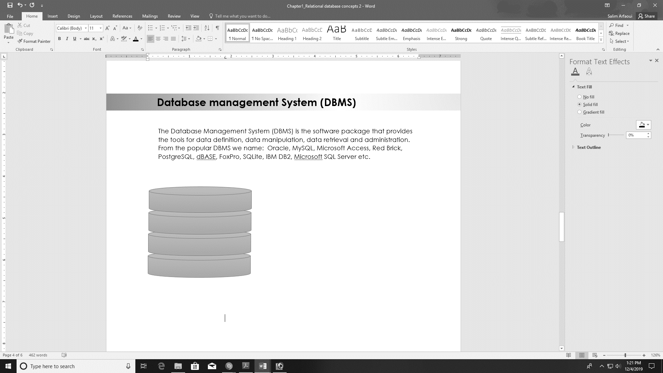

Database management System (DBMS)
The Database Management System (DBMS) is the software package used to:
Define the database structure.
Manipulate the data.
Data retrieval.
Administration.
End-users or Applications
DBMS
Database

Slide 11








Popular Database management Systems

Slide 12
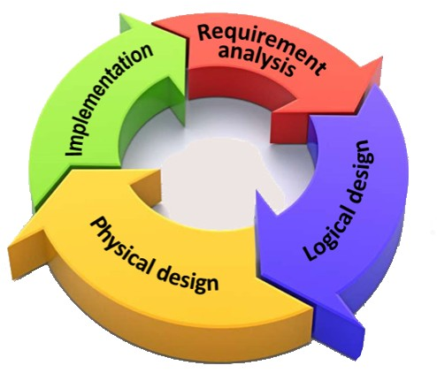
Database Development Life Cycle
Interviewing both the producers and users of data.
Requirement specification.
Creating and updating database.
Operation and monitoring.
Modifications.
Conceptual data modeling.
Normalization
Transformation of data model Into relational tables

Slide 13
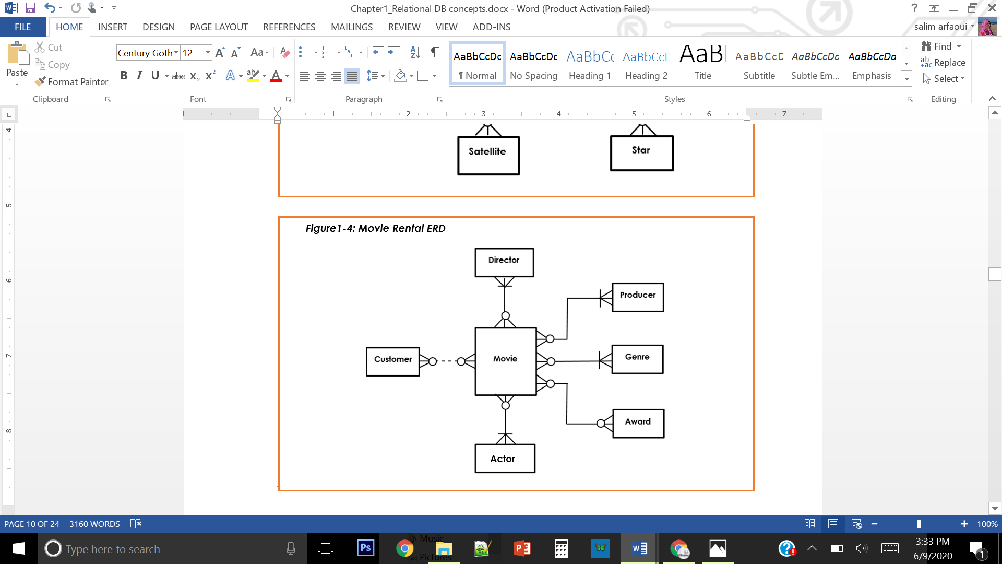
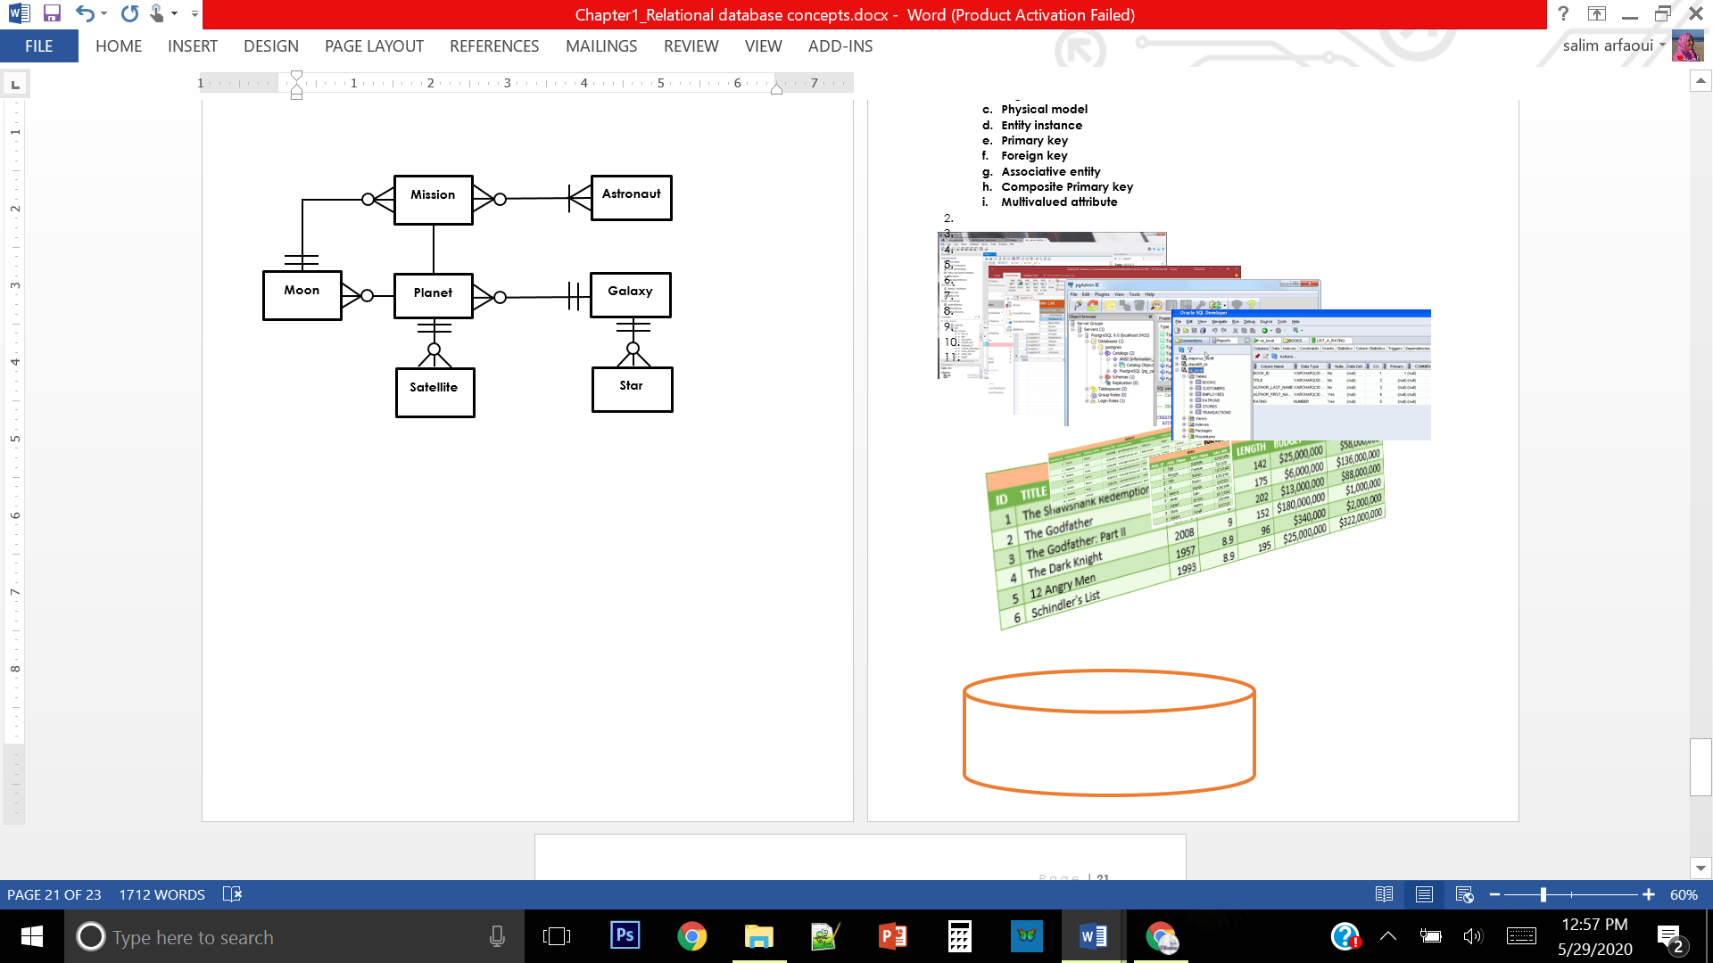
Database ERD
ERD: an abstraction of a real-world database. Depicts how the relational database is structured.
Useful in understanding complexities of the real-world environment
These diagram are examples of entity relationship diagrams (ERDs).

Slide 14
Database Data Model
Data model: A diagram that displays a set of tables and the relationships between them
Useful in understanding complexities of the real-world environment
These diagram are examples of entity relationship diagrams (ERDs).

Slide 15
Phase2: Logical design(ERD)
The major activity of this phase is identifying entities, attributes, and their relationships to construct model using the Entity Relationship Diagram.

Slide 16
ER Model Ingredients:

Slide 17
ER Model – Logical Data Model
The Entity Relationship Model is a high-level conceptual data model. Composed of:
Entities
Attributes
Relationships
Cardinality Symbols

Slide 18
Entity and Attributes
Entity: A person, business, organization, place, thing or event about which we want to store data.
ATTRIBUTE: An attribute is a single unit of data that describes something about an entity.
Identifier
ACTOR
Actor_ID (PK)
Actor_FName
Actor_LName
Actor_DOB
Entity Name
Attributes
Entity

Slide 19
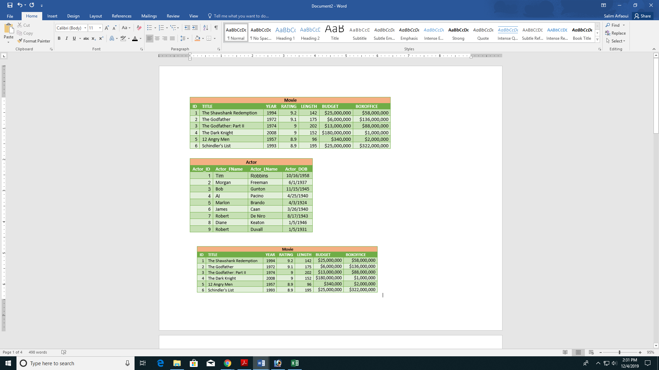
Entity Instance
An entity instance is a single occurrence of an entity.
Instances of the entity Actor.

Slide 20
How to find entities and attributes?
Entities: Look for singular nouns
BUT a proper noun is not a good candidate….
Tangible: customer, product
Intangible: order, accounting receivable
Attributes: Look for a descriptor whose values are associated with individual entities of a specific entity type
look for and extract those names that appear to be descriptive noun phrases.

Slide 21
How to find relationships?
Relationship: look for verbs
Relationships are associations between entities.
Typically, indicated by a verb connecting two or more entities.
Employees are assigned to projects
Relationships should be classified in terms of cardinality.
One-to-one, one-to-many, etc.

Slide 22
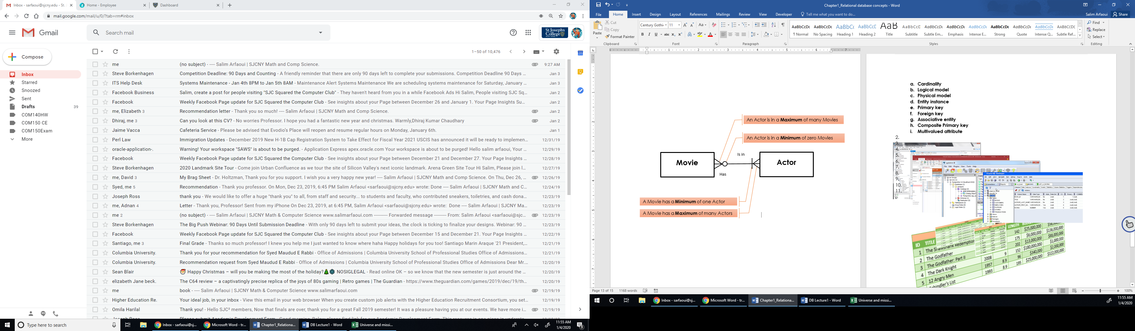
Movie-Actor Relationship

Slide 23
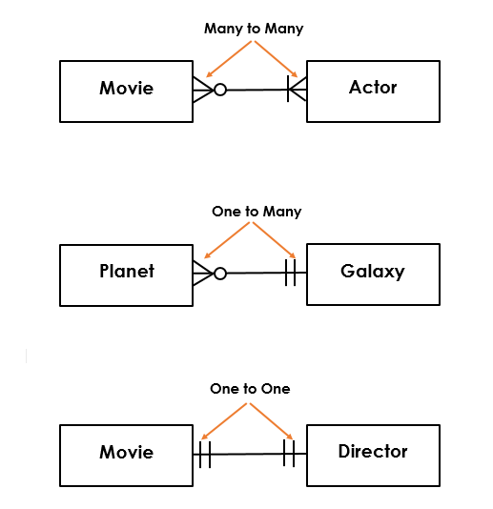
Types of relationships
There are three types of relationships:
Many to many
One to many
One to one

Slide 24
How to find cardinalities?
Cardinality: look for number of occurrences:
Cardinality is the number of occurrences in one entity which are associated to the number of occurrences in another.
There are three basic cardinalities (degrees of relationship).
Based on maximum cardinalities on both sides of the relationship
one-to-one (1:1),
one-to-many (1:M),
and many-to-many (M:N)

Slide 25
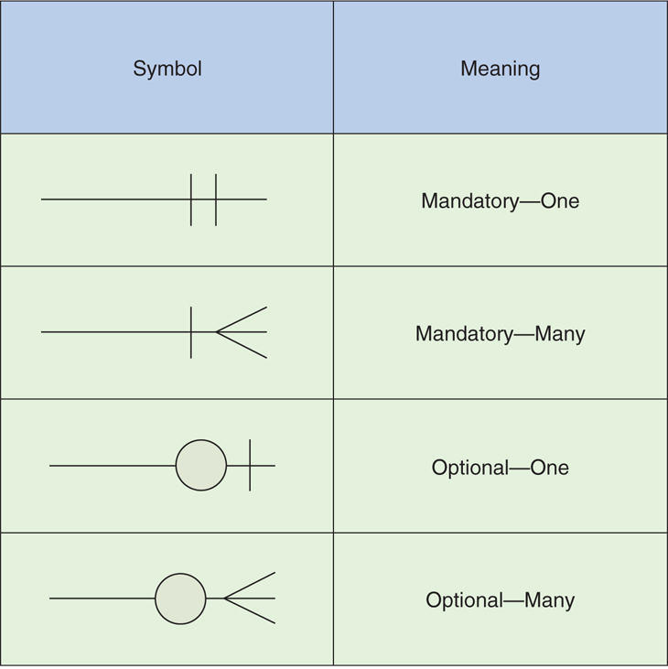
Cardinalities continued

Slide 26
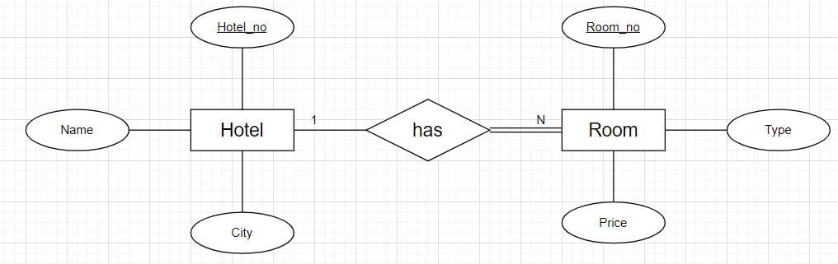
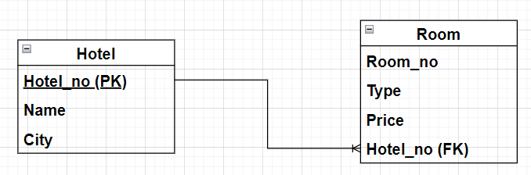
IE vs Chen Notation

Slide 27
From requirement specification to Logical Model >>> ERD
A professor teaches zero, one or many classes and a class is taught by one professor.
A course may generate zero, one or many classes and a class comes from one course.
3. A class is held in one room, but a room has zero or many classes.

Slide 28
Requirement specification to ERD >>> Entities
A professor teaches zero, one or many course-sections and a course-section is taught by one professor.
A course may generate zero, one or many course-sections and a course-section comes from one course.
3. A course-section is held in one room, but a room has zero or many course-sections.
Professor
course-section
Course
Room

Slide 29
Requirement specification to ERD >>> Relationships
A professor teaches zero, one or many course-sections and a course-section is taught by one professor.
A course may generate zero, one or many course-sections and a course-section comes from one course.
3. A course-section is held in one room, but a room has zero or many course-sections.
Teaches
Generates
Professor
course-section
Course
Comes from
Taught by
Has
Held in
Room

Slide 30
Requirement specification to ERD >>> Cardinalities
A professor teaches zero, one or many course-sections and a course-section is taught by one professor.
A course may generate zero, one or many course-sections and a course-section comes from one course.
3. A course-section is held in one room, but a room has zero or many course-sections.
Professor
Teaches
course-section
Generates
Course
Comes from
Taught by
Has
Held in
Room

Slide 31
Requirement specification to ERD >>> Attributes and Constraints
Course_Section
P_ID (FK)
Co_ID (FK)
R_Num (FK)
Professor
P_ID (PK)
P_Fname
P_LName
Course
Co_ID (PK)
Co_Description
Teaches
Generates
Taught by
Comes from
Has
Held in
Room
R_Num (PK)
R_Capacity

Slide 32
Logical to Physical Model
Translates a logical model into physical tables and constraints.
Logical Model | Physical Model
Entity | Table
Attribute | Column or field
Entity instance | Row in a table (record)
Relationship | A shared column in both related tables

Slide 33
Logical to Physical Model
Professor
P_ID (PK)
P_Fname
P_LName
Professor
12345
Eugene
Callahan
Entity Professor
An Instance of the
entity Professor
Becomes the record (row)
In Table Professor
P_ID | P_FName | P_LName
12345 | Eugene | Callahan

Slide 34
Logical to Physical Model
Professor
P_ID (PK)
P_FName
P_LName
Course
Co_ID (PK)
Co_Description
Room
R_Num (PK)
R_Capacity
P_ID (PK) | P_FName | P_LName
Number(5) | Varchar(25) | Varchar(25)
Co_ID (PK) | Co_Description
Varchar(5) | Varchar(200)
R_Num (PK) | R_Capacity
Varchar(4) | Number(3)
Course_Section
CS_ID
Co_ID (FK)
P_ID (FK)
R_Num (FK)
Composite PK
PK
CS_ID | Co_ID (FK) | P_ID (FK) | R_Num (FK)
Varchar(4) | Varchar(25) | Number(5) | Varchar(3)

Slide 35
In-class practice
We want to design a database for a local garage. For each customer, we want to record the (unique) Customer SS#, name, the customer address, and the contact phone number. For each vehicle, we want to record the unique vehicle’s identification number (VIN), and the vehicle’s make, model and year. For each repair job we want to record the description of the job done (maximum 200 chars), the date, and the total dollar cost. A repair job may involve zero or more parts (like, e.g., “windshield wipers”, “battery”, etc.) For each part we want to record its (unique) part number, the part name and its cost.
In addition, note that:
Each vehicle may have 1 or more repair jobs.
Each customer may be the primary owner of 1 or more vehicles.
Every vehicle has only one primary owner (we ignore co-owners).
No vehicle can have more than one repair job in any given day.
Q1. Draw an ER diagram for this database. Make sure to indicate primary keys and cardinality constraints.
Q2. Translate the ER diagram in Q1 into a relational model . Make sure that the translation captures key constraints (primary keys and foreign keys if applicable) and participation constraints in the ER diagram. Identify constraints, if any, that you are not able to capture.

